Slide 1
L6 Cache Part II
Zonghua Gu, 2018
4/30/2018
Acknowledgement: some slides taken from UC Berkeley CS61C

Slide 2
Cache (Performance) Terms
Hit rate: fraction of accesses that hit in the cache
Miss rate: 1 – Hit rate
Miss penalty: time to access a block from lower level in memory hierarchy
Hit time: time to access cache memory (including tag comparison)
4/30/2018

Slide 3
Average Memory Access Time (AMAT)
Average Memory Access Time (AMAT) is the average time to access memory considering both hits and misses in the cache
AMAT = Hit rate * Hit time + Miss rate * Miss time
= (1 – Miss rate)*Hit time + Miss rate * (Hit time + Miss penalty)
= Hit time + Miss rate * Miss penalty
For single-level cache, Miss penalty = Memory access time, since Miss time = Memory access time + Hit time
4/30/2018

Slide 4
AMAT Example
AMAT = Hit time + Miss rate * Miss penalty
Given a 200 psec clock, a miss penalty of 50 clock cycles, a miss rate of 2%, and a cache hit time of 1 clock cycle, what is AMAT?
A : ≤200 psec
B : 400 psec
C : 600 psec
D : ≥ 800 psec
AMAT=(1+.02*50)*200=400 psec
4/30/2018

Slide 5
Ping Pong Cache Example: DM Cache w/ 4 Blocks
Main Memory
0000xx
0001xx
0010xx
0011xx
0100xx
0101xx
0110xx
0111xx
1000xx
1001xx
1010xx
1011xx
1100xx
1101xx
1110xx
1111xx
Consider the sequence of memory addresses referenced at runtime :
0000xx, 0100xx, 0000xx, 0100xx, 0000xx, 0100xx, 0000xx, 0100xx
They all map to Set 0, which contains 1 cache block
Cache
Way
Set
Valid
Tag
Data
0
1
0
2
3

Slide 6
Ping Pong Cache Example: DM Cache w/ 4 Blocks
Consider the sequence of memory addresses referenced at runtime: 0000xx, 0100xx, 0000xx, 0100xx, 0000xx, 0100xx, 0000xx, 0100xx. All mapped to Set 0.
Start with an empty cache - all blocks initially marked as not valid
0000xx
miss
01
0100xx
miss
00
0000xx
miss
01
0100xx
miss
4
4
0
00 Mem(0)
00 Mem(0)
01 Mem(4)
00 Mem(0)
00
0000xx
miss
0
01
0100xx
miss
4
00
0000xx
miss
0
01
0100xx
miss
4
01 Mem(4)
00 Mem(0)
01 Mem(4)
00 Mem(0)
8 requests, 8 misses
Ping-pong effect due to conflict misses - two memory addresses that map into the same cache block
4/30/2018
Notes:
For class handout

Slide 7
Ping Pong Cache Example: 2-Way SA Cache w/ 4 Blocks
Main Memory
0000xx
0001xx
0010xx
0011xx
0100xx
0101xx
0110xx
0111xx
1000xx
1001xx
1010xx
1011xx
1100xx
1101xx
1110xx
1111xx
Consider the sequence of memory addresses referenced at runtime :
0000xx, 0100xx, 0000xx, 0100xx, 0000xx, 0100xx, 0000xx, 0100xx
They all map to Set 0, which contains 2 cache blocks
Cache
Way
Set
Valid
Tag
Data
0
0
1
1
0
1

Slide 8
Ping Pong Cache Example: 2-Way SA Cache w/ 4 Blocks
Consider the sequence of memory addresses referenced at runtime: 0000xx, 0100xx, 0000xx, 0100xx, 0000xx, 0100xx, 0000xx, 0100xx. All mapped to Set 0.
Start with an empty cache - all blocks initially marked as not valid
0000xx
miss
0100xx
miss
0000xx
hit
0100xx
hit
000 Mem(0)
000 Mem(0)
000 Mem(0)
000 Mem(0)
010 Mem(4)
010 Mem(4)
010 Mem(4)
…
…
8 requests, 2 misses
Two memory addresses that map into the same cache set can co-exist in the 2-way SA cache, removes the Ping-Pong effect of DM cache
4/30/2018
Notes:
For lecture
Another sample string to try 0 1 2 3 0 8 11 0 3

Slide 9
Cache Replacement Policies
Random Replacement
A cache block is randomly selected to evict
Least-Recently Used
Hardware keeps track of access history
Replace the entry that has not been used for the longest time
For 2-way SA cache, one bit per set → set to 1 when a block is referenced; reset the other way’s bit to 0; always replace the block with bit=0.
For N-way SA cache, can be expensive to implement
Example of a simple “Pseudo” LRU Implementation for 64-way SA cache
Replacement pointer points to one cache entry
Whenever access is made to the entry the pointer points to:
Move the pointer to the next entry
Otherwise: do not move the pointer
(example of “not-most-recently used” replacement policy)
Entry 0
Entry 1
Replacement
:
Pointer
Entry 63
4/30/2018
Notes:
For 2-way set-associative cache, need one bit for LRU replacement
Must track when each way’s block was used relative to other blocks in the set

Slide 10
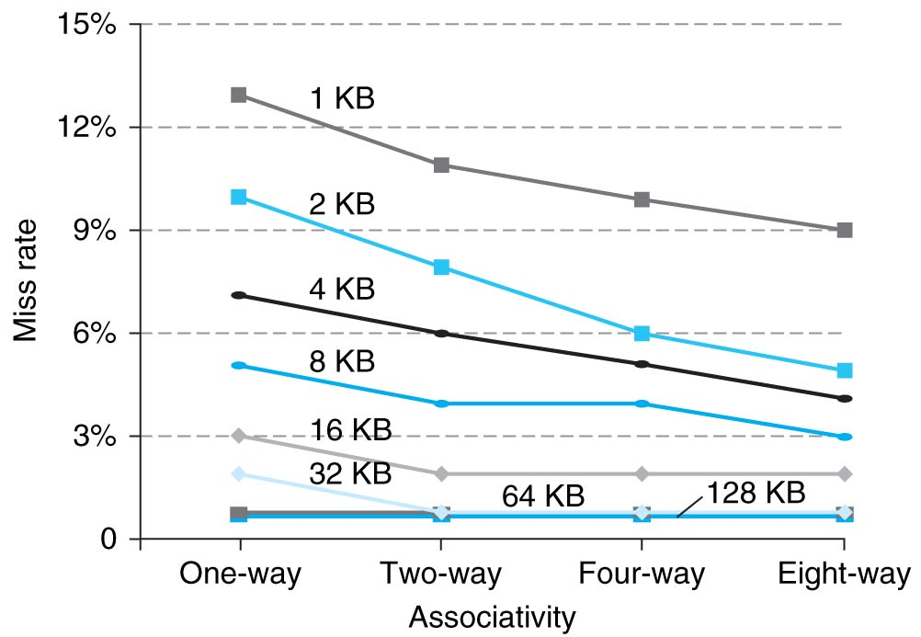
Benefits of Set-Associative Caches
Choice of DM $ versus SA $ depends on the cost of a miss versus the cost of implementation
Largest gains are in going from direct mapped to 2-way (20%+ reduction in miss rate)
4/30/2018
Notes:
As cache sizes grow, the relative improvement from associativity increases only slightly; since the overall miss rate of a larger cache is lower, the opportunity for improving the miss rate decreases and the absolute improvement in miss rate from associativity shrinks significantly.

Slide 11
Reduce AMAT
Reduce hit time
e.g., smaller cache, lower associativity
Reduce miss rate
e.g., larger cache, higher associativity
Reduce miss penalty
e.g., multiple-level cache hierarchy
Need to balance cache parameters (Capacity, associativity, block size)
4/30/2018

Slide 12
Sources of Cache Misses (3 C’s)
Compulsory: cold start, first access to a block
Misses that would occur even with infinite cache
Can be reduced by increasing block size
Capacity: cache is too small to hold all data needed by the program
Misses that would occur even under perfect replacement policy
Can be reduced by increasing cache capacity
Conflict: collisions due to multiple memory addresses mapped to same cache set
Recall the ping-pong cache example
Can be reduced by increasing associativity and/or increasing cache capacity
4/30/2018
Notes:
Compulsory misses are cache misses due to cold start. You cannot avoid them but if you are going to run billions of instructions anyway, compulsory misses usually don’t bother you.
Conflict misses are misses caused by multiple memory location being mapped to the same cache location.
The nightmare scenario is the ping pong effect when a block is read into the cache but before we have a chance to use it, it was immediately forced out by another conflict miss.
You can reduce Conflict misses by either increase the cache size or increase the associativity, or both.
Finally, Capacity misses occurs when the cache is not big enough to contains all the cache blocks required by the program. You can reduce this miss rate by making the cache larger.
(Capacity miss) That is the cache misses are due to the fact that the cache is simply not large enough to contain all the blocks that are accessed by the program.
The solution to reduce the Capacity miss rate is simple: increase the cache size.
Here is a summary of other types of cache miss we talked about.
First is the Compulsory misses. These are the misses that we cannot avoid. They are caused when we first start the program.
Then we talked about the conflict misses. They are the misses that caused by multiple memory locations being mapped to the same cache location.
There are two solutions to reduce conflict misses. The first one is, once again, increase the cache size. The second one is to increase the associativity.
For example, say using a 2-way set associative cache instead of directed mapped cache.
But keep in mind that cache miss rate is only one part of the equation. You also have to worry about cache access time and miss penalty. Do NOT optimize miss rate alone.
Finally, there is another source of cache miss we will not cover today. Those are referred to as invalidation misses caused by another process, such as IO , update the main memory so you have to flush the cache to avoid inconsistency between memory and cache.
+2 = 43 min. (Y:23)

Slide 13
Answer: # Cache Misses for DM Cache
Review
Consider the following program that repeatedly accesses an array of words A[4]
for (int i=0; i++, i<10000) {sum += A[0]+A[1]+A[2]+A[3];}
Suppose A[0] starts at memory address 000000, how many cache misses due to reading array A[] for a DM cache with either 1) the Tag-Set Index-Offset model; or 2) the Set Index-Tag-Offset model? How to classify the cache misses?
For Tag-Set Index-Offset model: 4 misses
1st cache miss brings into cache a block with address 0000xx into Set 0, which contains A[0]
2nd cache miss brings into cache a block with address 0001xx into Set 1, which contains A[1]
3rd cache miss brings into cache a block with address 0010xx into Set 2, which contains A[2]
4th cache miss brings into cache a block with address 0011xx into Set 3, which contains A[3]
9996 cache hits.
For Set Index-Tag-Offset model: 10000 misses
1st cache miss brings into cache a block with address 0000xx into Set 0, which contains A[0]
2nd cache miss brings into cache a block with address 0001xx into Set 0, which contains A[1], and replaces A[0]
3rd cache miss brings into cache a block with address 0010xx into Set 0, which contains A[2], and replaces A[1]
4th cache miss brings into cache a block with address 0011xx into Set 0, which contains A[3], and replaces A[2]
5th cache miss brings into cache a block with address 0000xx into Set 0, which contains A[0], and replaces A[3]
…
4 misses are all compulsory
4 misses are compulsory
9996 misses are conflict
Notes:
4 cache misses:

Slide 14
Answer: # Cache Misses for 2-Way SA Cache
Review
Consider the following program that repeatedly accesses an array of words A[4]
for (int i=0; i++, i<10000) {sum += A[0]+A[1]+A[2]+A[3];}
Suppose A[0] starts at memory address 000000, how many cache misses due to reading array A[] for a 2-way SA cache with either 1) the Tag-Set Index-Offset model; or 2) the Set Index-Tag-Offset model? How to classify the cache misses?
For Tag-Set Index-Offset model: 4 misses
1st cache miss brings into cache a block with address 0000xx into Set 0, which contains A[0]
2nd cache miss brings into cache a block with address 0001xx into Set 1, which contains A[1]
3rd cache miss brings into cache a block with address 0010xx into Set 0, which contains A[2]
4th cache miss brings into cache a block with address 0011xx into Set 1, which contains A[3]
9996 cache hits.
For Set Index-Tag-Offset model: 10000 misses
1st cache miss brings into cache a block with address 0000xx into Set 0, which contains A[0]
2nd cache miss brings into cache a block with address 0001xx into Set 0, which contains A[1]
3rd cache miss brings into cache a block with address 0010xx into Set 0, which contains A[2], and replaces one of A[0] or A[1]. Suppose A[0] is replaced.
4th cache miss brings into cache a block with address 0011xx into Set 0, which contains A[3], and replaces one of A[1] or A[2]. Suppose A[1] is replaced
5th cache miss brings into cache a block with address 0000xx into Set 0, and replaces one of A[2] or A[3]
…
4 misses are all compulsory
4 misses are compulsory
9996 misses are conflict
Notes:
4 cache misses:

Slide 15
Answer: # Cache Misses for FA Cache
Review
Consider the following program that repeatedly accesses an array of words A[4]
for (int i=0; i++, i<10000) {sum += A[0]+A[1]+A[2]+A[3];}
Suppose A[0] starts at memory address 000000, how many cache misses due to reading array A[] for a FA cache with either 1) the Tag-Set Index-Offset model; or 2) the Set Index-Tag-Offset model? How to classify the cache misses?
For either model: 4 misses
1st cache miss brings into cache a block with address 0000xx into Set 0, which contains A[0]
2nd cache miss brings into cache a block with address 0001xx into Set 0, which contains A[1]
3rd cache miss brings into cache a block with address 0010xx into Set 0, which contains A[2]
4th cache miss brings into cache a block with address 0011xx into Set 0, which contains A[3]
9996 cache hits.
4 misses are compulsory
Notes:
4 cache misses:

Slide 16
Effect of Cache Parameters on Performance
Larger cache size
reduces capacity and conflict misses
Increases hit time
Higher associativity
reduces conflict misses
increases hit time
Larger block size
reduces compulsory misses
increases conflict misses and miss penalty
Notes:
Requested line first….
The following could be in the slide…
spatial locality reduces compulsory misses and capacity reload misses
fewer lines may increase conflict miss rate
larger lines may increase miss penalty
Larger block size
reduces compulsory and capacity misses

Slide 17
Improving Cache Performance
AMAT = Hit time + Miss rate x Miss penalty
Reduce hit time
e.g., smaller cache, lower associativity
Reduce miss rate
e.g., larger cache, higher associativity
Reduce miss penalty
e.g., multiple-level cache hierarchy
4/30/2018
Notes:
Computer architects expend considerable effort optimizing the cache hierarchy

Slide 18
Memory Hierarchy
Processor
Inner
Increasing distance from processor, decreasing speed
Levels in memory hierarchy
Level 1
Level 2
Level 3
Outer
. . .
Level n
Size of memory at each level
As we move to lower levels, latency goes up and price per bit goes down.
4/30/2018

Slide 19
Multiple Cache Levels
Main Memory
L2$
L1$
CPU
Mem
Access
Miss
Hit
Miss
Hit
Path of Data Back to CPU
L1 cache size < L2 cache size << memory size

Slide 20
Local vs. Global Miss Rates
Local miss rate – the fraction of references to one level of a cache that miss
L2 Local Miss Rate = L2 Misses / L1 Misses
Global miss rate – the fraction of references that miss in all levels of caches and must go to memory
Global Miss rate = L2 Misses / Total Accesses
= (L2 Misses / L1 Misses) × (L1 Misses / Total Accesses)
= L2 Local Miss Rate × L1 Local Miss Rate
L1 Miss Penalty = L2 AMAT; L2 Miss Penalty = Memory access time
L1 cache only: AMAT = Hit Time + Miss rate × Miss penalty
L1+L2 caches: AMAT = L1 Hit Time + L1 Local Miss rate × (L2 Hit Time + L2 Local Miss rate × L2 Miss penalty)
4/30/2018

Slide 21
AMAT Example
L1 Hit Time: 1 cycle, L1 Miss Rate: 2%
L2 Hit Time: 5 cycle, L2 Miss Rate: 5%.
Main Memory access time: 100 cycles
No L2 Cache:
AMAT = 1 + .02*100 = 3
With L2 Cache:
AMAT = 1 + .02*(5 + .05*100) = 1.2

Slide 22
Multilevel Cache Considerations
Different design considerations for L1 Cache and LLC (Last Level Cache)
L1 Cache design should focus on fast access: minimize hit time to achieve shorter clock cycle, e.g., with smaller size, lower associativity; miss penalty is small thanks to L2 and lower caches, so higher miss rate is OK
LLC design should focus on low miss rate: miss penalty due to main memory access is very large, e.g., with larger size, higher associativity
Notes:
Global miss rate – the fraction of references that miss in all levels of a multilevel cache. The global miss rate dictates how often we must access the main memory.
Local miss rate – the fraction of references to one level of a cache that miss
For the L2$, fast hit time is less important than low miss rate
L2$ hit time determines L1$’s miss penalty
L2$ local miss rate >> global miss rate
Miss penalty of L1$ is significantly reduced by presence of L2$, so can be smaller/faster even with higher miss rate
\
Use multiple cache levels
2, 3 cache levels are common
High-end server may have ~1GB L4 cache off-chip

Slide 23
Summary
Calculation of AMAT
Three major categories of cache misses:
Compulsory Misses; Conflict Misses; Capacity Misses
Multi-level caches
Optimize 1st level to minimize hit time
Optimize last level to minimize miss rate
Lots of cache parameters (large design space)
Block size, cache size, associativity, write-back vs. write through, etc.
Notes:
Let’s summarize today’s lecture. I know you have heard this many times and many ways but it is still worth repeating.
Memory hierarchy works because of the Principle of Locality which says a program will access a relatively small portion of the address space at any instant of time.
There are two types of locality: temporal locality, or locality in time and spatial locality, or locality in space.
So far, we have covered three major categories of cache misses.
Compulsory misses are cache misses due to cold start. You cannot avoid them but if you are going to run billions of instructions anyway, compulsory misses usually don’t bother you.
Conflict misses are misses caused by multiple memory location being mapped to the same cache location.
The nightmare scenario is the ping pong effect when a block is read into the cache but before we have a chance to use it, it was immediately forced out by another conflict miss.
You can reduce Conflict misses by either increase the cache size or increase the associativity, or both.
Finally, Capacity misses occurs when the cache is not big enough to contains all the cache blocks required by the program. You can reduce this miss rate by making the cache larger.
There are two write policy as far as cache write is concerned. Write through requires a write buffer and a nightmare scenario is when the store occurs so frequent that you saturates your write buffer.
The second write polity is write back. In this case, you only write to the cache and only when the cache block is being replaced do you write the cache block back to memory.
+3 = 77 min. (Y:57)
Calculation of AMAT
Sources of Cache Misses (3 C’s)
Impact of Different Cache Parameters on Performance
Multilevel Cache Considerations

